Slide 1
Cloth Simulation
Chayapon Thunsetkul 6280742

Slide 2
Model

Slide 3
Mass-spring
F_{Spring} = -kx
The spring introduces a force on the particles.
This force is proportional to the displacement in the spring.
Opposite direction to the displacement
Particle_1
Particle_2
spring

Slide 4



Mass-spring
${\vec{f}}_{spring}=−k(length−\left|{\vec{p}}_{1}−{\vec{p}}_{2}\right|)$
$${\vec{p}}_{1}$$
$${\vec{p}}_{2}$$
length

Slide 5
Damping
F_{air} = -DV
Proportional to the velocity of each particle.
Opposite direction.
velocity V
F_{air} = - D V

Slide 6
Gravity
F_{gravity} = mg
A force acting on all points.
Downward direction
F_{gravity} = mg

Slide 7
All together
On a particle
F_{Spring} + F_{gravity} +F_{air} = ma
Second order ODE that needs to be solved for each particle

Slide 8
User Interactions

Slide 9
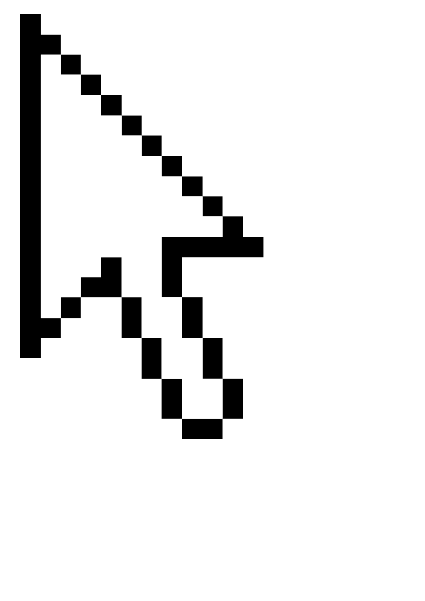
Dragging
A way to do this is to just check if the cursor is near a particle. If it is close enough, then move the particle to the location of the cursor
Particle
Particle
Check radius
Check radius

Slide 10
Dragging
To make it feels more realistic, a spring is created, joining the particle with the cursor.
Particle
Particle
Spring
Check radius

Slide 11





Cutting
Check if the cursor is between 2 ends of the spring using cross product and dot product.
$$\vec{b}$$
$$\vec{A }=\vec{b} −\vec{a}$$
$$\vec{a}$$
$$\vec{c}$$
$$\vec{C}=\vec{c} −\vec{a}$$

Slide 12



Cutting – Cross product
The cross product has a magnitude of the area of the parallelogram formed by the vectors.
It tells us how far the cursor is from the spring perpendicular axis
$$\vec{A }$$
area
$$\vec{A}×\vec{C}=Area \hat{n}$$
$$\vec{C}$$

Slide 13









Cutting – Cross product
$$\vec{A }$$
$$\vec{A }$$
$$\vec{A }$$
$$\vec{C}$$
$$\vec{C}$$
$$\vec{C}$$
$$\vec{A}×\vec{C}=Big Area$$
$$\vec{A}×\vec{C}=Small Area$$
$$\vec{A}×\vec{C}=Very Small Area$$

Slide 14




Cutting – Dot product
The dot product is the projection of a vector onto the unit vector of the other vector
It tells us how far the cursor is from the spring in a parallel axis
$$\vec{A }$$
$$\frac{\vec{C}⋅\vec{A}}{|\vec{A}|}=D$$
$$D$$
$$\vec{C}$$

Slide 15












Cutting – Dot product
$$\vec{A }$$
$$\vec{A }$$
$$D$$
$$\vec{A }$$
$$D$$
$$D$$
$$\vec{C}$$
$$\vec{C}$$
$$\vec{C}$$
$$\left|\vec{A}\right|<\frac{\vec{C}⋅\vec{A}}{|\vec{A}|}$$
$$\frac{\vec{C}⋅\vec{A}}{|\vec{A}|}<0$$
$$0<\frac{\vec{C}⋅\vec{A}}{|\vec{A}|}<|\vec{A}|$$

Slide 16







Cutting - conditions
$$\vec{A}×\vec{C}=Very Small Area$$
$$0<\vec{C}⋅\vec{A}<{\left|\vec{A}\right|}^{2}$$
$$\vec{A }$$
$$\vec{A }$$
$$D$$
$$\vec{C}$$
$$\vec{C}$$

Slide 17
https://github.com/r4b61t/Cloth-Simulation

